Slide 1
String Matching

Slide 2
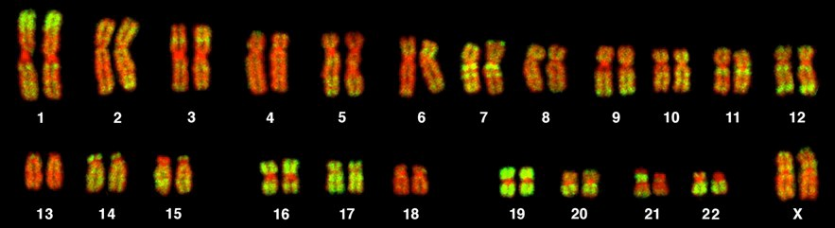
Exact String Search
Microscopy of chromosomes of a human female (karyotype):
ggccgggccctgtgaccacagtccacatcacaccaggacacagaggaagggccgggccctgtgaccacagtccacatcacaccaggacacagaggaagggccgggcctcatgaccacagt gtccacatcaca
Where does this string occur in the genome?

Slide 3

Exact String Matching
Exact String Matching Problem. Given a (long) string T and a shorter string P, find all occurrences of P in T. Occurrences of P are allowed to overlap.
Motivation is obvious:
search for words in long documents, webpages, etc.
find subsequences of DNA, proteins that are known to be important.
We’ll see 4 efficient algorithms for this problem.

Slide 4
String Matching Z

Slide 5
Exploiting Patterns in P
i
All this
happened, happy
more or less.
happy
After comparing “happy” to “happe” at iteration i,
we know that T[i...i+3] = “happ” = P[1...4]
we can deduce that there can be no match at i+1 because T[i+1] = P[2] = “a” but P[1] = “h”
in fact, since “h” does not appear in T[i...i+3] = P[1...4], we could set i = i + 4
Preprocess P to find these similarities.
Notes:
Since T will have matched some part of P, it is the similarities between various parts of P that allow us to make these deductions.

Slide 6
Z-Algorithm

Slide 7

Fundamental Preprocessing
Def. Zi(P) = the length of the longest substring of P that starts at i > 1 and matches a prefix of P.
Zi
Zi
P:
i
i + Zi - 1
P = “aardvark”: Z2 = 1, Z6 = 1
P = “alfalfa”: Z4 = 4
P = “photophosphorescent”: Z6 = Z10 = 3

Slide 8
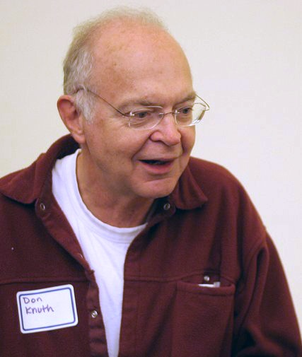
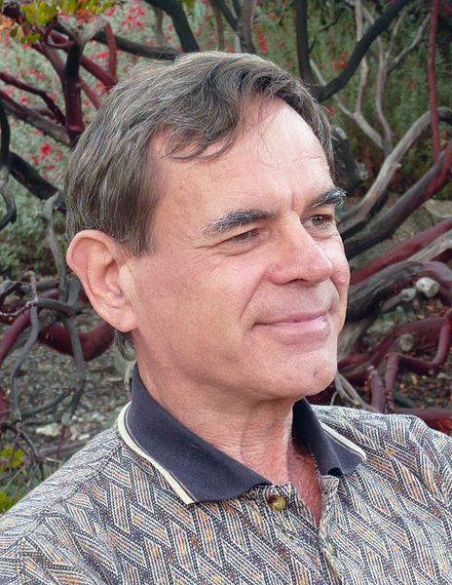
The KMP Algorithm
Knuth-Morris-Pratt Algorithm
Donald Knuth
A method of finding patterns , developed by
D. E. Knuth,
J. H. Morris and
V. R. Pratt.
Vaughan Pratt

Slide 9
The Knuth-Morris-Pratt algorithm
Best known
For linear time for exact matching
Preprocessing pattern P
Compares from Left to Right

Slide 10
The KMP Ideas
Shift more than one space
Reduce comparison

Slide 11
The KMP Algorithm - Motivation
When a mismatch occurs, what is the most we can shift the pattern?
.
.
a
b
a
a
b
?
.
.
.
.
.
Answer: the largest prefix of P[0..j-1] that is a suffix of P[1..j-1]
a
b
a
a
b
a
a
a
b
a
b
a
a
a
b
a
b
a
a
b
b
a
a
a
a
b
a
a
b
a
j
a
b
a
a
b
a
No need to
repeat these
comparisons
Resume
comparing
here

Slide 12
KMP Failure Function
Knuth-Morris-Pratt’s algorithm preprocesses the pattern to find matches of prefixes of the pattern with the pattern itself
The failure function F(j) is defined as the size of the largest prefix of P[0..j] that is also a suffix of P[1..j]
P:
a
b
a
a
b
a
j | 0 | 1 | 2 | 3 | 4 | 5
P[j] | a | b | a | a | b | a
F(j) | 0 | 0 | 1 | 1 | 2 | 3
j | 0 | 1 | 2 | 3 | 4 | 5
P[j] | a | b | a | a | b | a
F(j) | 0 | 0 | 1
j | 0 | 1 | 2 | 3 | 4 | 5
P[j] | a | b | a | a | b | a
F(j) | 0 | 0 | 1 | 1
j | 0 | 1 | 2 | 3 | 4 | 5
P[j] | a | b | a | a | b | a
F(j) | 0 | 0 | 1 | 1 | 2
j | 0 | 1 | 2 | 3 | 4 | 5
P[j] | a | b | a | a | b | a
F(j)
j | 0 | 1 | 2 | 3 | 4 | 5
P[j] | a | b | a | a | b | a
F(j) | 0
j | 0 | 1 | 2 | 3 | 4 | 5
P[j] | a | b | a | a | b | a
F(j) | 0 | 0

Slide 13
KMP Failure Function
Knuth-Morris-Pratt’s algorithm preprocesses the pattern to find matches of prefixes of the pattern with the pattern itself
The failure function F(j) is defined as the size of the largest prefix of P[0..j] that is also a suffix of P[1..j]
0
1
2
3
4
5
P:
a
b
a
c
a
b
j | 0 | 1 | 2 | 3 | 4 | 5
P[j] | a | b | a | c | a | b
F(j)
0
0
1
0
1
2

Slide 14
KMP Failure Function
Knuth-Morris-Pratt’s algorithm modifies the brute-force algorithm so that if a mismatch occurs at P[j] ≠ T[i] we set j ← F(j − 1)
j | 0 | 1 | 2 | 3 | 4 | 5
P[j] | a | b | a | a | b | a
F(j) | 0 | 0 | 1 | 1 | 2 | 3
i

Slide 15
The KMP Algorithm
Algorithm KMPMatch(T, P)
F ← failureFunction(P)
i ← 0
j ← 0
while i < n
if T[i] = P[j]
if j = m − 1
return i − j { match }
else
i ← i + 1
j ← j + 1
else
if j > 0
j ← F[j − 1]
else
i ← i + 1
return −1 { no match }

Slide 16
Example
j | 0 | 1 | 2 | 3 | 4 | 5
P[j] | a | b | a | c | a | b
F(j) | 0 | 0 | 1 | 0 | 1 | 2
a
b
a
c
a
a
b
a
c
c
a
b
a
c
a
b
a
a
b
b
1
2
3
4
5
6
a
b
a
c
a
b
7
a
b
a
c
a
b
Algorithm KMPMatch(T, P)
F ← failureFunction(P)
i ← 0
j ← 0
while i < n
if T[i] = P[j]
if j = m − 1
return i − j { match }
else
i ← i + 1
j ← j + 1
else
if j > 0
j ← F[j − 1]
else
i ← i + 1
return −1 { no match }
8
9
10
11
12
a
b
a
c
a
b
13
a
b
a
c
a
b
14
15
16
17
18
19
a
b
a
c
a
b

Slide 17
The KMP Algorithm
The failure function can be represented by an array and can be computed in O(m) time
At each iteration of the while-loop, either
i increases by one, or
the shift amount i − j increases by at least one (observe that F(j − 1) < j)
Hence, there are no more than 2n iterations of the while-loop
Thus, KMP’s algorithm runs in optimal time O(m + n)
Algorithm KMPMatch(T, P)
F ← failureFunction(P)
i ← 0
j ← 0
while i < n
if T[i] = P[j]
if j = m − 1
return i − j { match }
else
i ← i + 1
j ← j + 1
else
if j > 0
j ← F[j − 1]
else
i ← i + 1
return −1 { no match }

Slide 18
Computing the Failure Function
The failure function can be represented by an array and can be computed in O(m) time
The construction is similar to the KMP algorithm itself
At each iteration of the while-loop, either
i increases by one, or
the shift amount i − j increases by at least one (observe that F(j − 1) < j)
Hence, there are no more than 2m iterations of the while-loop
Algorithm failureFunction(P)
F[0] ← 0
i ← 1
j ← 0
while i < m
if P[i] = P[j]
{we have matched j + 1 chars}
F[i] ← j + 1
i ← i + 1
j ← j + 1
else if j > 0 then
{use failure function to shift P}
j ← F[j − 1]
else
F[i] ← 0 { no match }
i ← i + 1

Slide 19
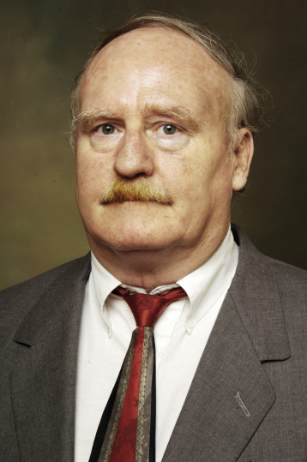
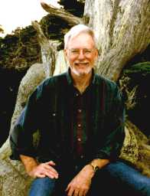
About the Creators
Robert Boyer is a retired Professor Emeritus of the University of Texas at Austin Computer Science Department. He received his BA and PhD in mathematics at UT Austin, and has authored and co-authored several books concerning automatic theorem-proving.
J. Strother Moore is Admiral B.R. Inman Centennial Chair in Computer Theory of the Department of Computer Sciences at UT Austin. He received his BS in mathematics from MIT in 1970, and his PhD in computational logic from the University of Edinburgh in 1973. He has authored and co-authored several books concerning automatic theorem-proving, some of them in cooperation with Robert Boyer.

Slide 20
Boyer-Moore’s Algorithm
http://www.cs.utexas.edu/users/moore/best-ideas/string-searching
The Boyer-Moore’s pattern matching algorithm is based on two principles
- Right to Left Scan
- Bad character shift

Slide 21
Right to left Scan Rule
a | b | a | c | a | a | b | a | d | c | a | b | a | c | a | b | a | a | b
a | b | a | c | a | b

Slide 22
Right to left Scan Rule
a | b | a | c | a | a | b | a | d | c | a | b | a | c | a | b | a | a | b
a | b | a | c | a | b

Slide 23
Right to left Scan Rule
a | b | a | c | a | a | b | a | d | c | a | b | a | c | a | b | a | a | b
a | b | a | c | a | b

Slide 24
Right to left Scan Rule
a | b | a | c | a | a | b | a | d | c | a | b | a | c | a | b | a | a | b
a | b | a | c | a | b

Slide 25
Right to left Scan Rule
a | b | a | c | a | a | b | a | d | c | a | b | a | c | a | b | a | a | b
a | b | a | c | a | b

Slide 26
Right to left Scan Rule
a | b | a | c | a | a | b | a | d | c | a | b | a | c | a | b | a | a | b
a | b | a | c | a | b

Slide 27
Right to left Scan Rule
a
b
a
c
a
a
b
a
d
c
a
b
a
c
a
b
a
a
b
b
1
a
b
a
c
a
b
4
3
2
a
b
a
c
a
b
5
a
b
a
c
a
b
6
a
b
a
c
a
b

Slide 28
Bad Character Shift Rule
Shift More than one position at a time.
When a mismatch occurs at T[i] = c
If P contains c, shift P to align the last occurrence of c in P with T[i]
- | - | - | - | - | - | x | h | a | p | p | - | - | - | - | - | - | - | -
T:
P:
x | c | x | d | q | b | y | h | a | p | p
shift
P:
x | c | x | d | q | b | y | h | a | p | p

Slide 29
Bad Character Shift Rule
When a mismatch occurs at T[i] = c
If P contains c, shift P to align the last occurrence of c in P with T[i]
Else, shift P to align P[0] with T[i + 1]
- | - | - | - | - | - | x | h | a | p | p | - | - | - | - | - | - | - | -
T:
P:
x | c | x | d | q | b | y | h | a | p | p
shift
P:
x | c | x | d | q | b | y | h | a | p | p

Slide 30
Bad Character Shift Rule
When a mismatch occurs at T[i] = c
If P contains c, shift P to align the last occurrence of c in P with T[i]
Else, shift P to align P[0] with T[i + 1]
What if we have already crossed the last occurrence?
- | - | - | - | - | - | p | h | a | p | p | - | - | - | - | - | - | - | -
T:
P:
x | c | x | d | q | b | y | h | a | p | p
shift
P:
x | c | x | d | q | b | y | h | a | p | p

Slide 31
Boyer-Moore’s Algorithm
Example
a
p
a
t
t
e
r
n
m
a
t
c
h
i
n
g
a
l
g
o
r
i
t
h
m
r
i
t
h
m

Slide 32
Boyer-Moore’s Algorithm
Example
a
p
a
t
t
e
r
n
m
a
t
c
h
i
n
g
a
l
g
o
r
i
t
h
m
r
i
t
h
m

Slide 33
Boyer-Moore’s Algorithm
Example
a
p
a
t
t
e
r
n
m
a
t
c
h
i
n
g
a
l
g
o
r
i
t
h
m
r
i
t
h
m

Slide 34
Boyer-Moore’s Algorithm
Example
a
p
a
t
t
e
r
n
m
a
t
c
h
i
n
g
a
l
g
o
r
i
t
h
m
r
i
t
h
m

Slide 35
Boyer-Moore’s Algorithm
Example
a
p
a
t
t
e
r
n
m
a
t
c
h
i
n
g
a
l
g
o
r
i
t
h
m
1
3
5
11
10
9
8
7
r
i
t
h
m
r
i
t
h
m
r
i
t
h
m
r
i
t
h
m
2
4
6
r
i
t
h
m
r
i
t
h
m
r
i
t
h
m

Slide 36
Example
a
b
a
c
a
a
b
a
d
c
a
b
a
c
a
b
a
a
b
b
1
a
b
a
c
a
b
4
3
2
13
12
11
10
9
8
a
b
a
c
a
b
a
b
a
c
a
b
5
7
a
b
a
c
a
b
a
b
a
c
a
b
6
a
b
a
c
a
b

Slide 37
Last-Occurrence Function
preprocesses the pattern P and the alphabet Σ to build the last-occurrence function L mapping Σ to integers, where L(c) is defined as
the largest index i such that P[i] = c or −1 if no such index exists
Example:
Σ = {a, b, c, d}
P = abacab
The last-occurrence function can be computed in time O(m + s), where m is the size of P and s is the size of Σ
c | a | b | c | d
L(c)
4
5
3
-1

Slide 38
The Boyer-Moore Algorithm
Case 1: j < l
Algorithm BoyerMooreMatch(T, P, Σ )
L ← lastOccurenceFunction(P, Σ )
i ← m − 1
j ← m − 1
repeat
if T[i] = P[j]
if j = 0
return i { match at i }
else
i ← i − 1
j ← j − 1
else
{ character-jump }
until i > n − 1
return −1 { no match }
Case 2: l < j
l ← L[T[i]]
i ← i + m – min(j, 1 + l)
j ← m − 1

Slide 39
Analysis
Boyer-Moore’s algorithm is significantly faster than the brute-force algorithm on English text
Boyer-Moore’s algorithm runs in time O(nm + s)
Example of worst case:
T = aaa … a
P = baaa
The worst case may occur in images and DNA sequences but is unlikely in English text

Slide 40
The Boyer-Moore algorithm
Extended Bad character shift rule
then shift P to the right so that the closest x to the left of position i in P is below the mismatched x in T.
The original Boyer-Moore algorithm use the simpler bad character rule

Slide 41
The Boyer-Moore algorithm
Extended Bad character shift rule
T: ------xhapp-----
P: xcxdqbyhaxp
012345678901
R(x)=2
P: xcxdqbyhaxp
The position of x is 9,2,0
Find the top number < j

Slide 42
Rabin-Karp Algorithm

Slide 43
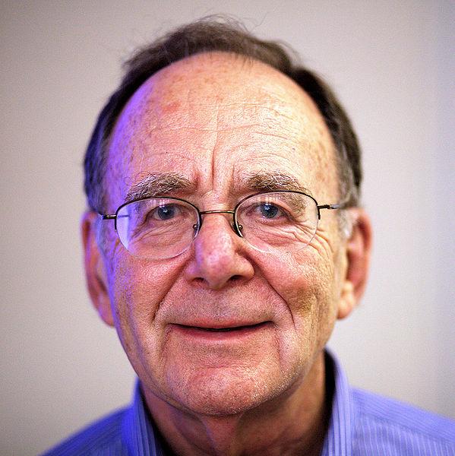
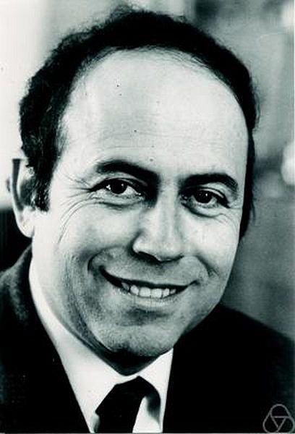
Rabin-Karp algorithm
Richard Manning Karp
Michael Oser Rabin

Slide 44
Rabin-Karp algorithm
Use a function T to that computes a numerical representation of P
Calculate T for all m symbol sequences of S and compare
P = ABA
S = BABABBABABA

Slide 45
Rabin-Karp algorithm
Use a function T to that computes a numerical representation of P
Calculate T for all m symbol sequences of S and compare
P = ABA
Hash P
T(P)
S = BABABBABABA

Slide 46
Rabin-Karp algorithm
- Use a function T to that computes a numerical representation of P - Calculate T for all m symbol sequences of S and compare
P = ABA
Hash m symbol sequences and compare
S = BABABBABABA
T(BAB)
=
T(P)

Slide 47
Rabin-Karp algorithm
- Use a function T to that computes a numerical representation of P - Calculate T for all m symbol sequences of S and compare
P = ABA
match
Hash m symbol sequences and compare
S = BABABBABABA
T(ABA)
=
T(P)

Slide 48
Rabin-Karp algorithm
- Use a function T to that computes a numerical representation of P - Calculate T for all m symbol sequences of S and compare
P = ABA
Hash m symbol sequences and compare
S = BABABBABABA
T(BAB)
=
T(P)

Slide 49
Rabin-Karp algorithm
- Use a function T to that computes a numerical representation of P - Calculate T for all m symbol sequences of S and compare
P = ABA
Hash m symbol sequences and compare
S = BABABBABABA
…
T(BAB)
=
T(P)

Slide 50
Rabin-Karp algorithm
For this to be useful/efficient, what needs to be true about T?
P = ABA
S = BABABBABABA
…
T(BAB)
=
T(P)

Slide 51
Rabin-Karp algorithm
For this to be useful/efficient, what needs to be true about T?
P = ABA
Given T(s_{i…i+m-1}) we must be able to efficiently calculate T(s_{i+1…i+m})
S = BABABBABABA
…
T(BAB)
=
T(P)

Slide 52
Calculating the hash function
For simplicity, assume Σ = (0, 1, 2, …, 9). (in general we can use a base larger than 10).
A string can then be viewed as a decimal number
How do we efficiently calculate the numerical representation of a string?
T(‘9847261’) = ?

Slide 53
Horner’s rule
9847261
9 * 10 = 90
(90 + 8)*10 = 980
(980 + 4)*10 = 9840
(9840 + 7)*10 = 98470
… = 9847621

Slide 54
Horner’s rule
9847261
Running time?
9 * 10 = 90
Θ(m)
(90 + 8)*10 = 980
(980 + 4)*10 = 9840
(9840 + 7)*10 = 98470
… = 9847621

Slide 55
Calculating the hash on the string
Given T(s_{i…i+m-1}) how can we efficiently calculate T(s_{i+1…i+m})?
m = 4
963801572348267
T(s_{i…i+m-1})

Slide 56
Calculating the hash on the string
Given T(s_{i…i+m-1}) how can we efficiently calculate T(s_{i+1…i+m})?
m = 4
801
963801572348267
T(s_{i…i+m-1})
subtract highest order digit

Slide 57
Calculating the hash on the string
Given T(s_{i…i+m-1}) how can we efficiently calculate T(s_{i+1…i+m})?
m = 4
8010
963801572348267
T(s_{i…i+m-1})
shift digits up

Slide 58
Calculating the hash on the string
Given T(s_{i…i+m-1}) how can we efficiently calculate T(s_{i+1…i+m})?
m = 4
8015
963801572348267
T(s_{i…i+m-1})
add in the lowest digit

Slide 59
Calculating the hash on the string
Given T(si…i+m-1) how can we efficiently calculate T(si+1…i+m)?
m = 4
Running time?
963801572348267
- Θ(m) for s_{1…m}
- O(1) for the rest
T(s_{i…i+m-1})

Slide 60
Algorithm so far…
Is it correct?
Each string has a unique numerical value and we compare that with each value in the string
Running time
Preprocessing:
Θ(m)
Matching
Θ(n-m+1)
Is there any problem with this analysis?

Slide 61
Algorithm so far…
Is it correct?
Each string has a unique numerical value and we compare that with each value in the string
Running time
Preprocessing:
Θ(m)
Matching
Θ(n-m+1)
How long does the check T(P) = T(s_{i…i+m-1}) take?

Slide 62
Modular arithmetics
The run time assumptions we made were assuming arithmetic operations were constant time, which is not true for large numbers
To keep the numbers small, we’ll use modular arithmetics, i.e. all operations are performed mod q
a+b = (a+b) mod q
a*b = (a*b) mod q
…

Slide 63
Modular arithmetics
If T(A) = T(B), then T(A) mod q = T(B) mod q
In general, we can apply mods as many times as we want and we will not effect the result
What is the downside to this modular approach?
Spurious hits: if T(A) mod q = T(B) mod q that does not necessarily mean that T(A) = T(B)
If we find a hit, we must check that the actual string matches the pattern

Slide 64
Runtime
Preprocessing
Θ(m)
Running time
Best case:
Θ(n-m+1) – No matches and no spurious hits
Worst case
Θ((n-m+1)m)

Slide 65
Average case running time
Assume v valid matches in the string
What is the probability of a spurious hit?
As with hashing, assume a uniform mapping onto values of q:
What is the probability under this assumption?
Σ*
1…q

Slide 66
Average case running time
Assume v valid matches in the string
What is the probability of a spurious hit?
As with hashing, assume a uniform mapping onto values of q:
What is the probability under this assumption? 1/q
Σ*
1…q

Slide 67
Average case running time
How many spurious hits?
n/q
Average case running time:
O(n-m+1) + O(m(v+n/q)
iterate over the positions
checking matches and spurious hits

Slide 68
Matching running times
Algorithm Preprocessing time Matching time
Naïve 0 O((n-m+1)m) FSA Θ(m|Σ|) Θ(n) Rabin-Karp Θ(m) O(n-m+1)m) Knuth-Morris-Pratt Θ(m) Θ(n)

Slide 69
Huffman coding for Text Compression
Text Compression: Minimizing the number of bits used to represent text data.
Because I’m bad, I’m bad-- come on
Bad, bad-- really, really bad
You know I’m bad, I’m bad--
You know it
Bad, bad-- really, really bad
You know I’m bad, I’m bad-- come on, you know
Bad, bad-- really really bad.
T = total bits = 148 characters x 8 bits/character
T = 1184 bits

Slide 70
Huffman coding
Phrase Symbol Frequency
Because b 1
I’m I 6
Bad B 15
Come on C 2
It I 1
Really R 6
You know Y 4
Because I’m bad, I’m bad-- come on
Bad, bad-- really, really bad
You know I’m bad, I’m bad--
You know it
Bad, bad-- really, really bad
You know I’m bad, I’m bad-- come on, you know
Bad, bad-- really really bad.
Word Frequency
total symbols = 7
Bits per symbol = ceil(log 7) = 3
T = total bits = 35 symbols x 3 bits/symbol
T = 105 bits

Slide 71
Huffman coding
Prefix code:
No character code is a prefix of another character code.
Phrase Symbol Frequency Code Length Code
Because b 1 5 00001
I’m I 6 3 011
Bad B 15 1 1
Come on C 2 4 0001
It I 1 5 00000
Really R 6 3 010
You know Y 4 3 001
T = 15(1) + 6(3) + 6(3) + 4(3)
+ 2(4) + 1(5) + 1(5)
T = 15 + 18 + 18 + 12 + 4 + 5 + 5
= 81 bits
Huffman Codes

Slide 72
Huffman coding
35
1
0
Huffman Tree
Bad
20
15
01
00
T = 15(1) + 6(3) + 6(3) + 4(3)
+ 2(4) + 1(5) + 1(5)
T = 15 + 18 + 18 + 12 + 4 + 5 + 5
= 81 bits
12
8
010
000
011
001
I’m
Really
You Know
4
6
6
4
0001
0000
Phrase Symbol Frequency Code Length Code
Because b 1 5 00001
I’m I 6 3 011
Bad B 15 1 1
Come on C 2 4 0001
It I 1 5 00000
Really R 6 3 010
You know Y 4 3 001
Come on
2
2
00001
00000
Because
It
1
1

Slide 73
Huffman Tree Construction
Phrase Symbol Frequency Code Length Code
Because b 1
I’m I 6
Bad B 15
Come on C 2
It I 1
Really R 6
You know Y 4
Greedy Method
Forest of Trees
Because
I’m
Bad
Come on
It
Really
You Know
1
6
15
2
1
6
4

Slide 74
Huffman Tree Construction
Phrase Symbol Frequency Code Length Code
Because b 1
I’m I 6
Bad B 15
Come on C 2
It I 1
Really R 6
You know Y 4
Greedy Method
Forest of Trees
2
I’m
Bad
Come on
Really
You Know
Because
It
6
15
2
6
4
1
1

Slide 75
Huffman Tree Construction
Phrase Symbol Frequency Code Length Code
Because b 1
I’m I 6
Bad B 15
Come on C 2
It I 1
Really R 6
You know Y 4
Greedy Method
4
Forest of Trees
Come on
2
2
I’m
Bad
Really
You Know
Because
It
6
15
6
4
1
1

Slide 76
Huffman Tree Construction
Phrase Symbol Frequency Code Length Code
Because b 1
I’m I 6
Bad B 15
Come on C 2
It I 1
Really R 6
You know Y 4
8
Greedy Method
You Know
4
4
Forest of Trees
Come on
2
2
I’m
Bad
Really
Because
It
6
15
6
1
1

Slide 77
Huffman Tree Construction
Phrase Symbol Frequency Code Length Code
Because b 1
I’m I 6
Bad B 15
Come on C 2
It I 1
Really R 6
You know Y 4
12
8
Greedy Method
I’m
Really
You Know
4
6
6
4
Forest of Trees
Come on
2
2
Bad
Because
It
15
1
1

Slide 78
Huffman Tree Construction
Phrase Symbol Frequency Code Length Code
Because b 1
I’m I 6
Bad B 15
Come on C 2
It I 1
Really R 6
You know Y 4
20
12
8
Greedy Method
I’m
Really
You Know
4
6
6
4
Forest of Trees
Come on
2
2
Bad
Because
It
15
1
1

Slide 79
Huffman Tree Construction
35
Phrase Symbol Frequency Code Length Code
Because b 1
I’m I 6
Bad B 15
Come on C 2
It I 1
Really R 6
You know Y 4
Bad
20
15
12
8
Greedy Method
I’m
Really
You Know
4
6
6
4
Huffman Tree
Come on
2
2
Because
It
1
1

Slide 80
Huffman Tree Construction
35
Phrase Symbol Frequency Code Length Code
Because b 1
I’m I 6
Bad B 15 1 1
Come on C 2
It I 1
Really R 6
You know Y 4
1
0
Bad
20
15
12
8
Greedy Method
I’m
Really
You Know
4
6
6
4
Huffman Tree
Come on
2
2
Because
It
1
1

Slide 81
Huffman Tree Construction
35
Phrase Symbol Frequency Code Length Code
Because b 1
I’m I 6
Bad B 15 1 1
Come on C 2
It I 1
Really R 6
You know Y 4
1
0
Bad
20
15
01
00
12
8
010
001
011
001
Greedy Method
I’m
Really
You Know
4
6
6
4
Huffman Tree
Come on
2
2
Because
It
1
1

Slide 82
Huffman Tree Construction
35
Phrase Symbol Frequency Code Length Code
Because b 1
I’m I 6 3 011
Bad B 15 1 1
Come on C 2
It I 1
Really R 6 3 010
You know Y 4 3 001
1
0
Bad
20
15
01
00
12
8
010
000
011
001
Greedy Method
I’m
Really
You Know
4
6
6
4
Huffman Tree
Come on
2
2
Because
It
1
1

Slide 83
Huffman Tree Construction
35
Phrase Symbol Frequency Code Length Code
Because b 1
I’m I 6 3 011
Bad B 15 1 1
Come on C 2 4 0001
It I 1
Really R 6 3 010
You know Y 4 3 001
1
0
Bad
20
15
01
00
12
8
010
000
011
001
Greedy Method
I’m
Really
You Know
4
6
6
4
0001
0000
Huffman Tree
Come on
2
2
Because
It
1
1

Slide 84
Huffman Tree Construction
35
Phrase Symbol Frequency Code Length Code
Because b 1 5 00001
I’m I 6 3 011
Bad B 15 1 1
Come on C 2 4 0001
It I 1 5 00000
Really R 6 3 010
You know Y 4 3 001
1
0
Bad
20
15
01
00
12
8
010
000
011
001
Greedy Method
I’m
Really
You Know
4
6
6
4
0001
0000
Huffman Tree
Come on
2
2
00001
00000
Because
It
1
1

